Slide 1
Training Presentation

Slide 2
Topics Covered
Access Training
Portable Ramps
Modular Ramps

Slide 3
Access Training Topics
What is Rise/Slope?
What questions should we ask our customers?
How to pick the perfect ramp
Where else do I need access?
Why buy PVI?
Selection Video
Click link to watch the selection video

Slide 4
Training- What is Rise?
Rise is the total vertical distance from where the customer is at, to where they want to be.
Rise is measured in inches from the highest point to the lowest point of the applications. See Example A.
Example A:
The average stair step can vary greatly, so always measure for an accurate total rise.
Because the ground is not always level, be sure to include any variation in the “Rise” of the ground when getting this measurement.
Total Inches of Rise
Rise

Slide 5
Training- What is Slope?
Slope is how steep the ramp will be once it is put in place. For example: a 2:12 slope means that for every 2 inches of rise, you must have 1 foot of ramp to accommodate. Here are the recommendations for slope according to the ADA:
1:12 Slope (4.8°)
The ADA recommended slope for long (up to 30ft) home and commercial ramps.
Works for most strong unassisted manual chair users, although PVI always recommends assistance.
2:12 Slope (9.6°)
Acceptable grade for portable ramp use with all occupied chairs and scooters.
Able assistant required for all loading and unloading of occupied chairs and scooters.
3:12 Slope (14.5°)
For loading unoccupied chairs and scooters ONLY.

Slide 6
Training- What Questions to Ask
Every need will be different, so be sure to listen carefully to your customer.
The #1 reason a ramp is returned is due to it being the incorrect size which is almost always.....TOO SHORT!
Main objection to overcome with almost every interaction: shorter ramps are less expensive and weigh less, thus preferred by customers.

Slide 7
Training- What Questions to Ask
The Basic Questions for General Use:
Can the person who handles the ramp easily lift:
A) A 5-gallon bucket of water (42lbs)–Almost any ramp will work
B) A large bag of ice (25lbs)-Most ramps will work (splitting a multifold)
C) A 24-pack of soda (18lbs)-Singlefold ramps or split a multifold ramp in half
D) A gallon of milk (9lbs)-Some Singlefold and most thresholds
Is the ramp for a temporary use or long term?
Is this for a bariatric client?
Most importantly, listen for any clues that would raise a “red flag” towards misuse by the customer. Safety is the #1 goal when helping our customers.

Slide 8
Training- What Questions to Ask
The Basic Questions for Home Use:
How will you primarily use this ramp?
Is this for a manual or power-chair user?
If manual, is the user able-bodied enough for unassisted use?
Do you have access to assistance when using the ramp?
Explain the slope recommendations per ADA guidelines, then ask what slope they feel would work best.
For the primary home use, what is the rise? (explain rise to customer)
Is the home a permanent or temporary location?

Slide 9
Training- What Questions to Ask
The Basic Questions for Auto Use:
How will you primarily use this ramp?
Do you have access to assistance when using the ramp?
If using for a vehicle, these 3 rules apply:
Must not exceed 2:12 slope
Must have adequate head clearance
Always have a qualified assistant

Slide 10
Training- What Questions to Ask
The Basic Questions for Auto Use (con’t):
For the primary auto use, what is the rise? (explain rise to customer)
What type of Vehicle is being used?
(Helps determine ramp style)

Slide 11
Training-How to Pick the Perfect Ramp
Once you have gathered the necessary information, it is time to pick the perfect ramp.
Use the rise and slope information to determine the correct length. This slope-rise calculator will help.
Now that you know the length needed, choose the style and model that will work best for the customers needs and abilities.
Review the options with the customer and let them make the final decision if there is more than one style/model option.

Slide 12
Training-How to Pick the Perfect Ramp
Review
Before you finalize the purchase, make sure the following objectives are covered
Rise Measurement
Slope Needed
Lifting capabilities of customer/assistant
You know of any additional needs
Style/model options are reviewed and recommendation is given
Customer makes final decision on product choice

Slide 13
Training-Where Else Do I Need Access?
Often overlooked, a great question to ask your customer is, “Where else do you need access?”
This question can save the customer time and money by packaging multiple products together to save on shipping as well as dealing with one person who has already gathered their information for access needs.
This question can also increase your sales by suggestively selling additional products the customer may have overlooked at the moment.

Slide 14
Training-Where Else Do I Need Access?
Access opportunities often overlooked:
Back door access
Garage/carport access
Sliding glass door/patio access
Vehicle access
Friend/family home access
Park/community gathering access
Motor home/RV access
In-home access (not including staircases)
Plus many many more! Just be sure to ask the question every time…. “Where else do you need access?”

Slide 15
Training- Why Buy PVI?
100% American-Made
Industry leader in quality and safety
20 years of experience in ramp manufacturing and design
Limited Lifetime Warranty
Pound for pound the lightest and strongest ramps made
Eco-friendly ramps: 70% recycled aluminum and 100% recycled packaging
Patented technology keeps your customer safe
UL Listed for Safety….no other brand is!
Cutting edge innovation combined with streamlined production provides the best products at the best prices
Named “World’s Greatest” Ramp Manufacturer

Slide 16
BONUS What Does “UL Listed” Mean?
Underwriter Laboratories or “UL” is a third party testing group. In order to receive their stamp of approval, a company must pass their strict standards for safety.
The standards set by UL when it comes to portable ramps states that a portable ramp must:
Be able to hold 4X the stated capacity (most PVI ramps state a capacity of 600lbs)
Hold this total weight on 4 distinct points
Be able to function normally after having weight applied and removed
PVI manufactures the only ramps that have passed these strict standards for safety.

Slide 17
Portable Ramp Topics
Overview
Singlefold Ramps
Multifold Ramps
Solid Ramps
Threshold Ramps

Slide 18
Portable Ramps-Overview
Designed specifically for access needs for customers in manual and powered chairs.
Lightweight, easy to use, and portable for multiple location uses.
4 basic styles: Multifold, Singlefold, Solid, and Threshold
Each style has unique features that fit a customers different needs.
8in-12ft length range in this category.
Aircraft-grade aluminum construction for stability, durability, and low weights.
6000 Series Aluminum
All come with Limited Lifetime Warranties.

Slide 19
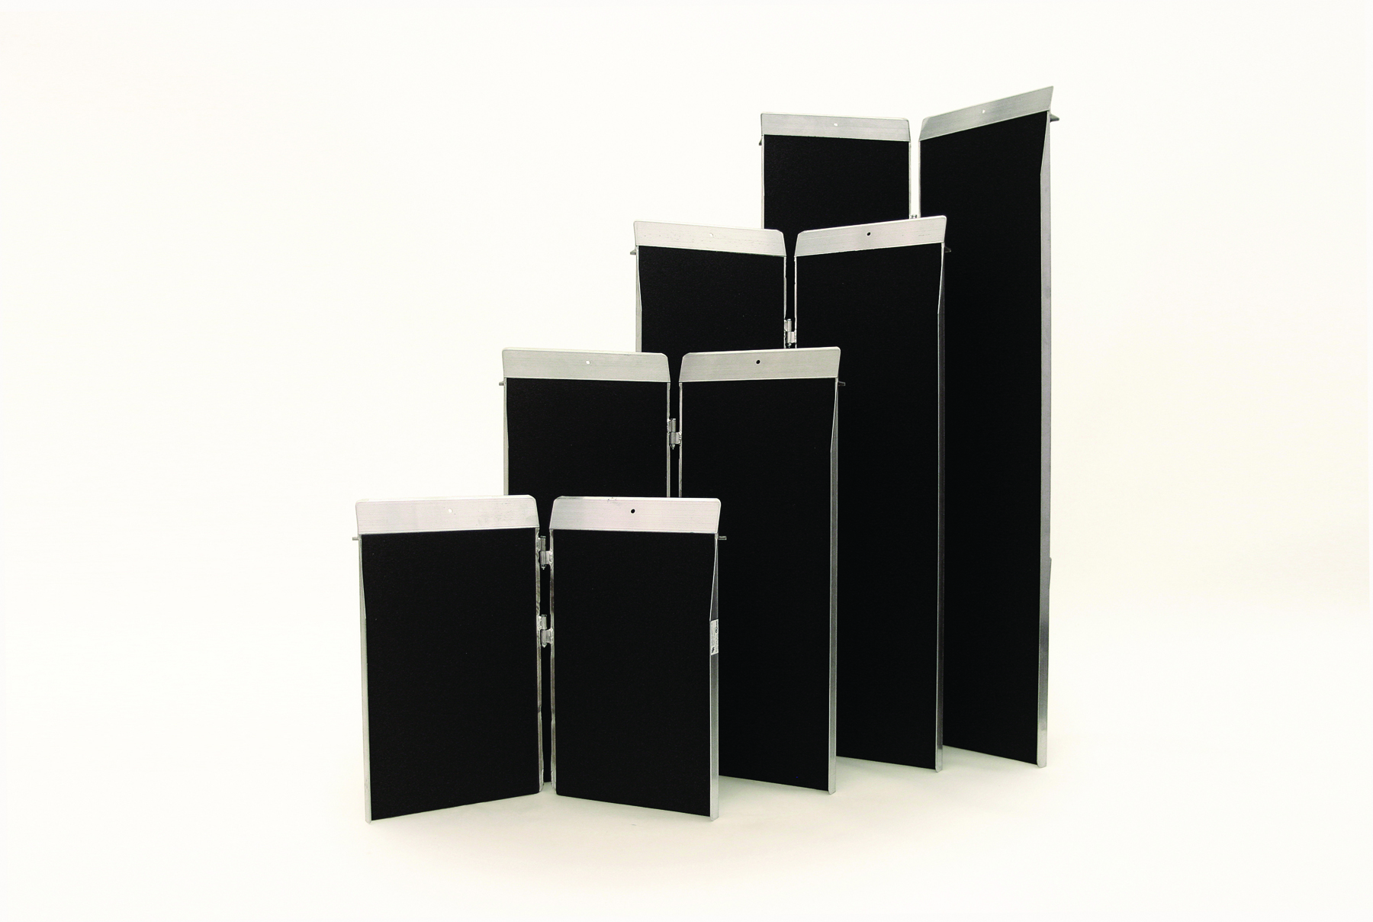
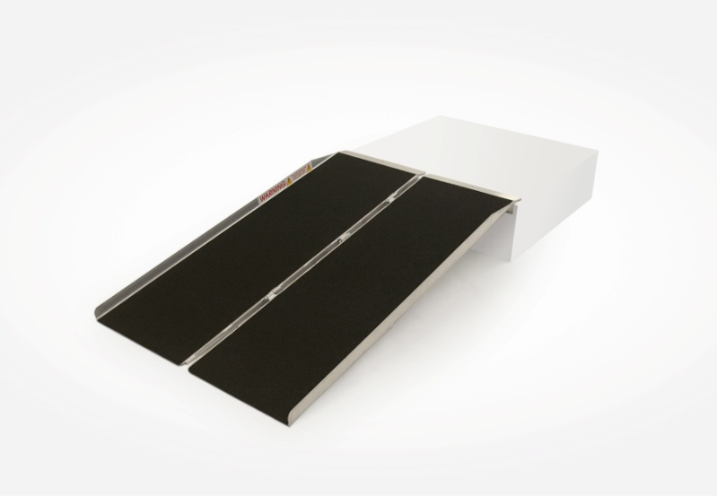
Portable Ramps-Singlefold

Slide 20
Portable Ramps-Singlefold
Fold in half (down the middle of the ramp) for easier carrying and storage
UL Rated at 600lbs
Available in 2, 3, 4, 5, 6, 7, and 8ft lengths
Edge-to-Edge anti-slip traction tape
30in width accommodates most wheelchairs and scooters
All welded construction…no rivets (which is common among competing brands)

Slide 21
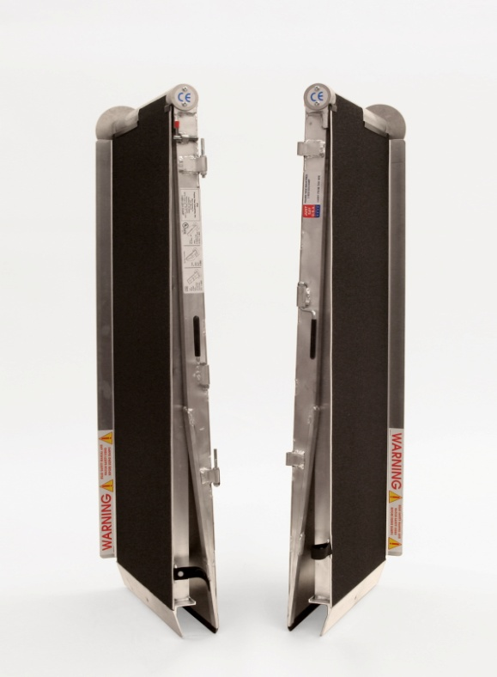
Portable Ramps-Multifold

Slide 22
Portable Ramps-Multifold
Folds twice for a decreased footprint for storage…perfect for vehicles
Patented “No-Pinch” hinge eliminates dangerous pinch-points
Separates into 2 pieces with the rotation of a pin for easier handling
Available in 5, 6, 7, 8, 10, and 12ft lengths
UL listed at 600lbs (10 and 12ft models carry a 500lb listing)
All welded construction…no rivets (which is common among competing brands)

Slide 23
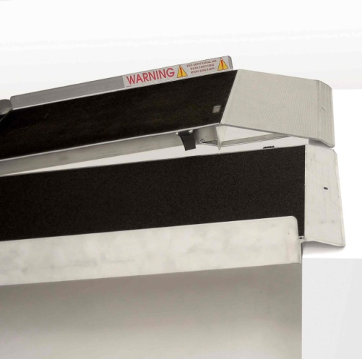
Portable Ramps-Multifold
Edge-to-Edge anti-slip traction tape
30in width accommodates most wheelchairs and scooters
Built-in safety guide indicates if ramp is on a safe slope
See comparison to another leading brand here
Available in Utility Version (6, 7, 8, and 10ft)
Extended hook to clear rear bumper ➔
Straps included for extra stability
Available in Bariatric Version (5, 6, 7, and 8ft)
Heavy duty capacity of 800lbs
36in wide platform

Slide 24
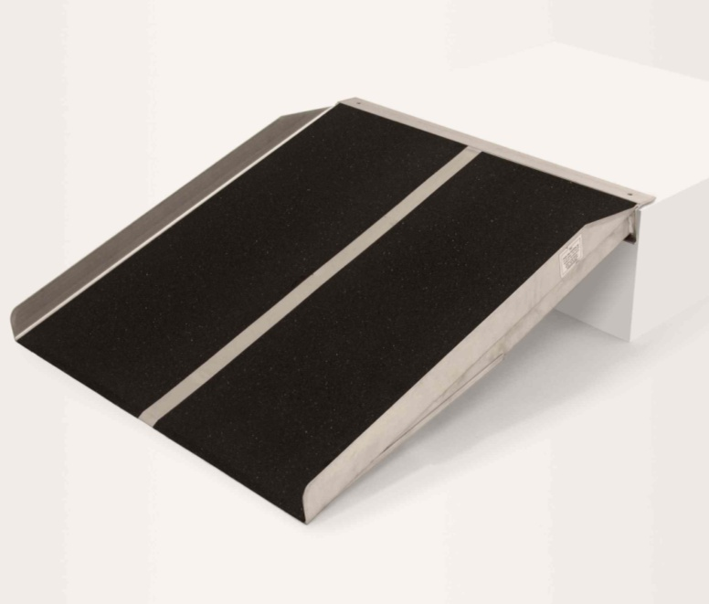
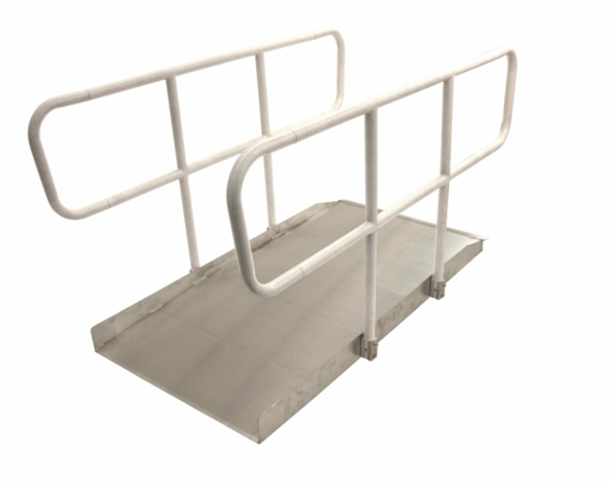
Portable Ramps-Solid

Slide 25
Portable Ramps-Solid
Perfect semi-permanent solution
Available with or without handrails
Without handrails:
Available in 3, 4, and 5ft length
Available in 30 and 36in widths
Edge-to-Edge anti-slip traction tape
Durable welded construction
Full platform provides excellent stability
UL Rated at 600lbs
Limited Lifetime Warranty
Available in Bariatric Panel version (800lb capacity)

Slide 26
Portable Ramps-Solid
With handrails (Called “OnTrac”):
Available in 4, 5, 6, 7, and 8ft lengths
36in wide platform
Anti-slip grooved aluminum traction
Powder-coated, ADA compliant handrails
Weight capacity of 100lbs per sq. ft.
Easy setup design, all hardware included
Smooth transition design- 2 ft of decreased slope
Limited Lifetime Warranty*
*Does not cover powder-coating

Slide 27
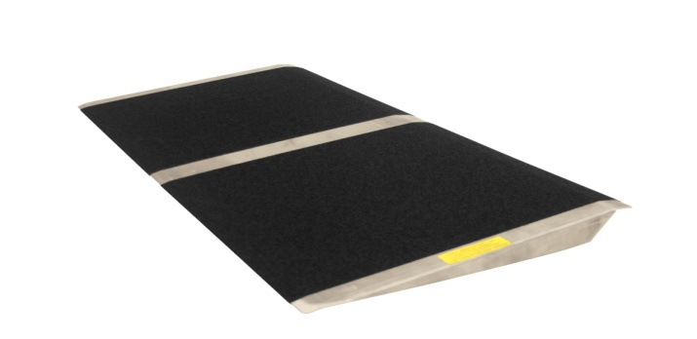
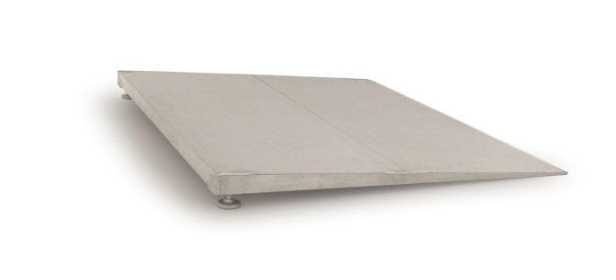
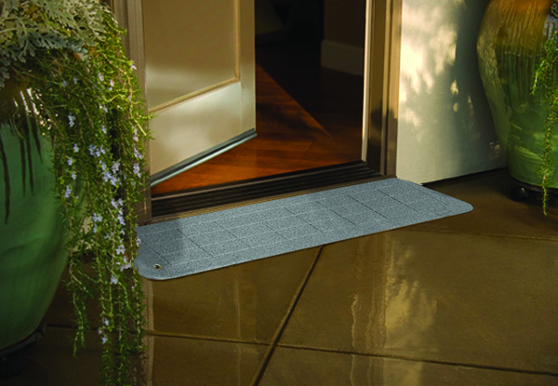
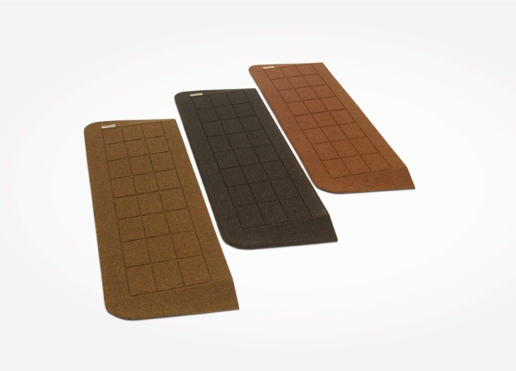
Portable Ramps-Threshold

Slide 28
Portable Ramps-Threshold
Ideal for almost any doorway or location that has a rise of 4 inches or less
Multiple sizes and versions available to create the perfect fit
All come with Limited Lifetime Warranty
Made from Aluminum, Plastic, or Rubber
When deciding which one to choose ask…
Threshold rise needed to overcome?
Which way does the door swing? (if used in a doorway)
Width of doorway threshold? (if used in a doorway)

Slide 29
Portable Ramps-Threshold
Sizes and Styles:
Standard Threshold
8-24in lengths
32in widths
Threshold heights of ¼in to 4in
Rated at 600lbs
Bariatric Threshold
800lb weight rating
16 and 24in lengths
36in width
Threshold heights of 1½ to 4in

Slide 30
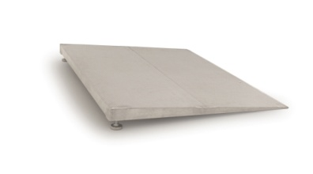
Portable Ramps-Threshold
Sizes and Styles:
Self-Supporting Threshold
16 and 24in lengths
36in width
Threshold heights of 1½ in to 3in
Rated at 600lbs
Adjustable Self-Supporting Threshold
600lb weight rating
12 and 24in lengths
32in width
Threshold heights of 1½ to 4in
Adjustable feet for precise threshold match

Slide 31
Portable Ramps-Threshold
Sizes and Styles:
Plastic Bighorn™ Threshold-100% recycled plastic
8.125in length
42in width
Can be shimmed to 2in rise
Rated at 1000lbs
Rubber Stonecap™ Threshold-100% recycled rubber
No Weight Limit
8.125 to 24in lengths
42 to 60in width
36 ¼ to 50in of usable width
Threshold heights of 7/8in to 2in
Beveled edges for entry from any angle

Slide 32
Modular Ramps
Overview
Modular XP
Installation Video
Assessment Guide
Click link to watch the installation video
Click link to print Assessment Guide

Slide 33
Modular Ramps-Overview
Semi-permanent structures that allow access into a building. PVI Modular ramps are designed for ADA compliance.
PVI Modular Ramps are made from aircraft-grade aluminum for durability.
Won’t rust, rot, or deteriorate.
Each system is a custom design to fit perfectly for the customer’s needs.
An assessment is required on all applications to determine the length of ramp needed.

Slide 34
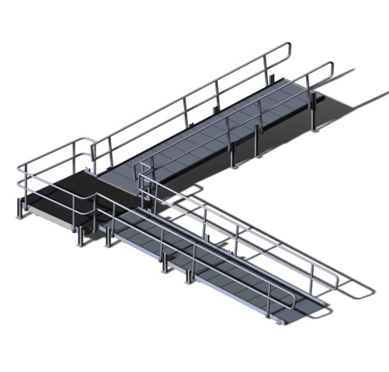
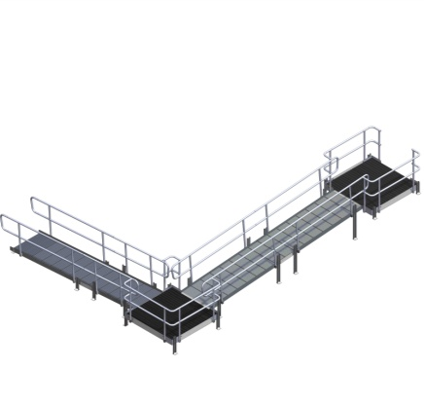
Modular Ramps-XP
XP stands for Express
36in width (ADA compliant)
100lbs per sq. ft. load capacity
4ft minimum to any length
2in Curb throughout system
Bubble levels on every platform for safety
Deep V-tread for maximum traction
Powder-coated handrails for grip and cleanliness
Limited Lifetime Warranty (does not cover powder-coating)

Slide 35
Training Complete!
Please click here to download and save the RAMP REFERENCE GUIDE for quick and easy answers to common questions.
This program utilizes buttons to help get you to where you need fast. Just click and go!
Thank you for your support of PVI products

